Slide 1
Consider the following propositions
P: David is playing pool
Q: David is inside
R: David is doing his homework
S: David is listening to music
Translate following sentences into symbolic notations
Either David is playing pool or he is inside
Neither is David playing pool, nor is he doing his homework
David is playing pool and not doing his homework
David is inside doing his homework, not playing pool
David is inside doing his homework while listening to music, and he is not playing pool
David is not listening to music, nor is he playing pool, neither is he doing his homework.

Slide 2
Prove the following are tautologies
Conjunction of two tautologies is tautology
P V ~P = ?
(R->S) v ~(R->S ) ?
((P v S )^ R) v ~ ((P v S )^ R)

Slide 4
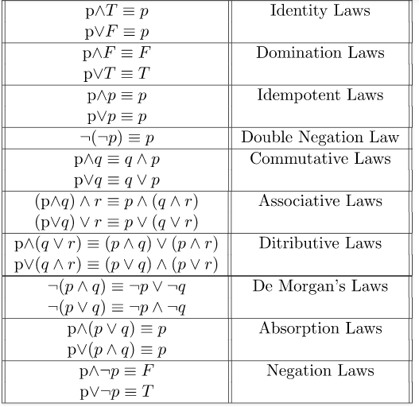
Logical equivalences

